Slide 1
Tutorial 11
Statistical Computation and Analysis
Spring 2025

Slide 2
Tutorial Outline
Categorical predictors
Bayesian reporting

Slide 3
Categorical Predictors
We mainly saw independent variables that were continuous.
There are cases when they are categorical.
Male, female
Morning, afternoon, evening
We can still do linear regression.
We need to encode the categorical variable as numbers.
Bambi

Slide 4
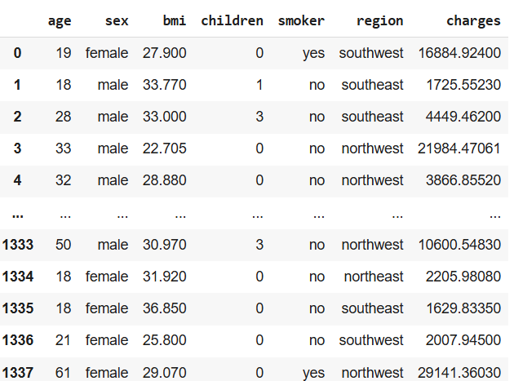
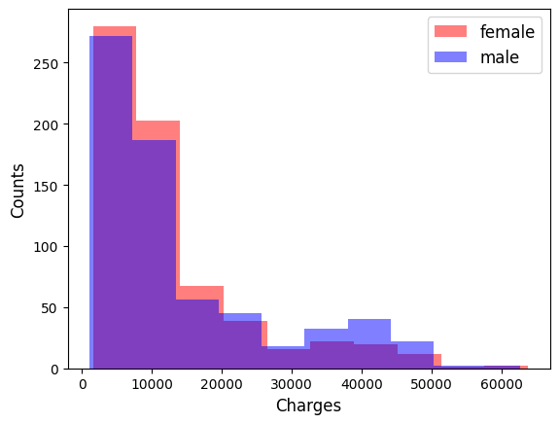
Categorical Predictors
We have insurance costs for males and females.

Slide 5

Categorical Predictors
Let’s use bambi to assess the effect of gender on insurance charges.
We don’t need to tell bambi if a variable is categorical.
Bambi detects and handles them automatically.

Slide 6
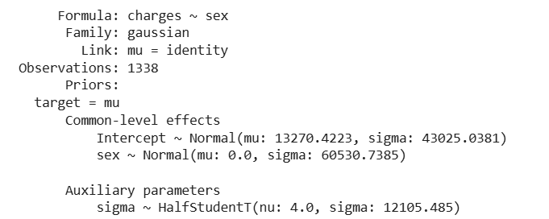

Categorical Predictors
We can examine the model:
The model that we fit is: $charges=β_{0}+b_{1}⋅sex$

Slide 7
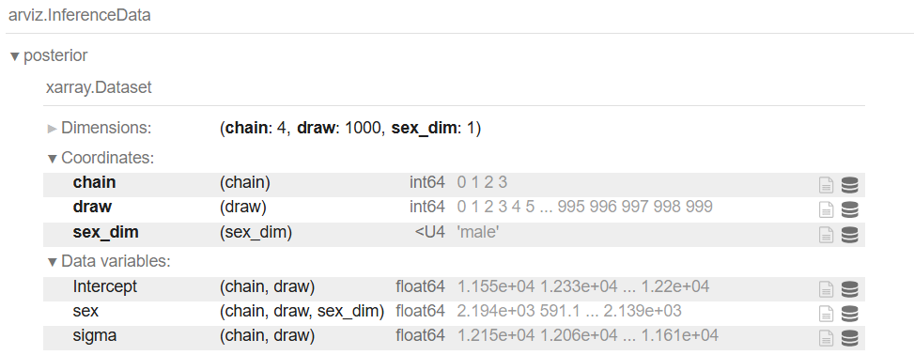
Categorical Predictors
And the inference data object:

Slide 8
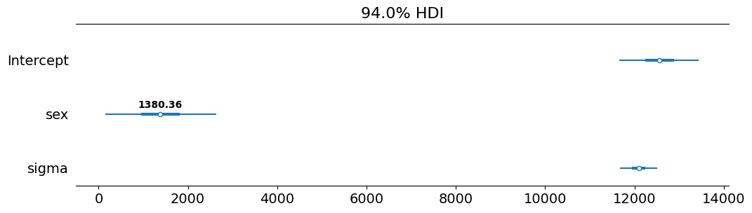
Categorical Predictors
We can see that the gender dimension is one, even though there are two genders.
Bambi encodes categorical variables with N levels (2 genders) as N-1 dummy variables (1 gender).
This means that on average the cost for males is 1380.36 more than for females.

Slide 9
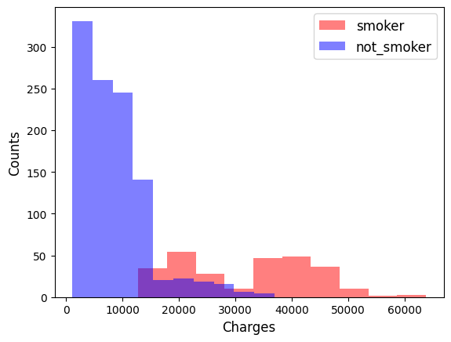
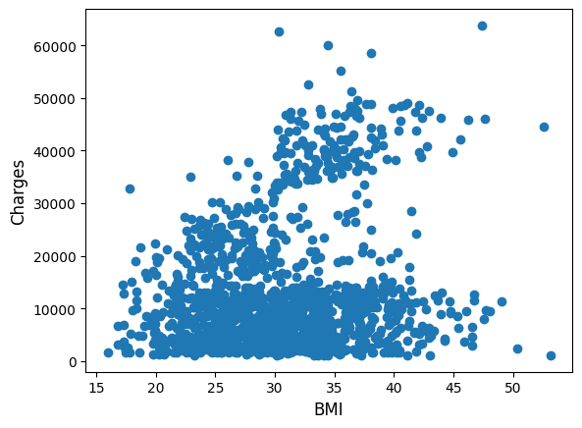
Categorical Predictors
Our dataset also contains other information, such as if the person smokes (categorical) and their BMI (continuous).

Slide 10


Categorical Predictors
We can fit a model to each independent variable.

Slide 11
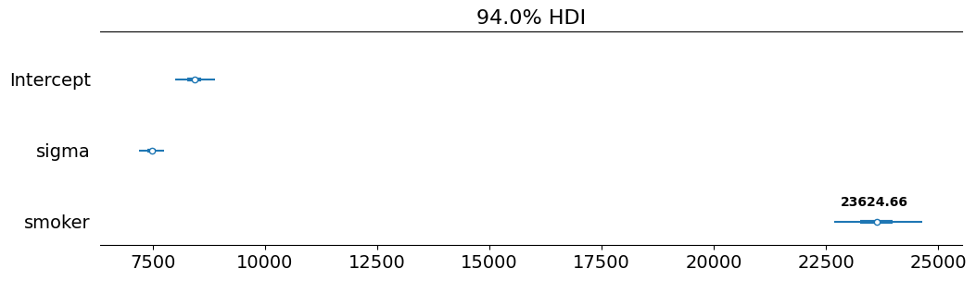
Categorical Predictors
Results smoker:
We need to add 23624 to smoker charges relative to not smoker.

Slide 12
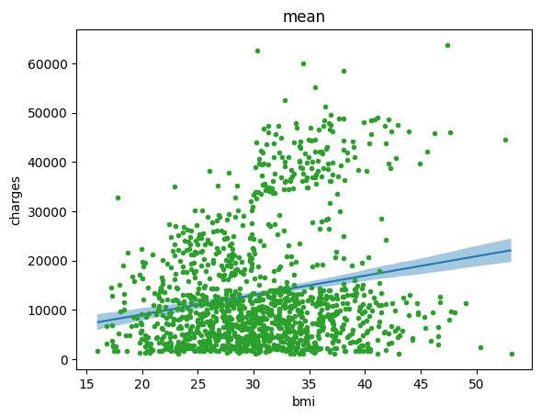
Categorical Predictors
Results bmi:

Slide 13
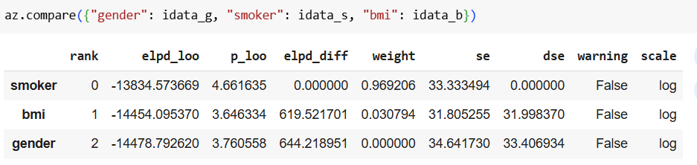
Categorical Predictors
How do we know which model is best?
We can compare using LOO.
And we can see that the smoker model is the best, as expected based on the data.

Slide 14
Multiple Regression
Instead of using only one variable at a time, we can use multiple regression.
For example, look at the regression of the insurance charges as a function of BMI (continuous) and smoker (categorical).

Slide 15
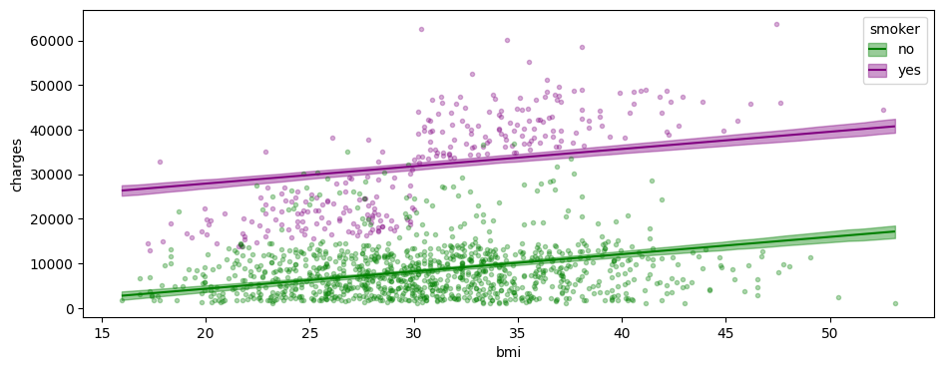
Multiple Regression
Results:

Slide 16
Multiple Regression
The results of this model show some relation between charges and bmi, and the difference we saw between smokers and non-smokers.
The two lines are essentially parallel to each other, with the difference in height showing the amount needed to add to the smokers’ charges.

Slide 17
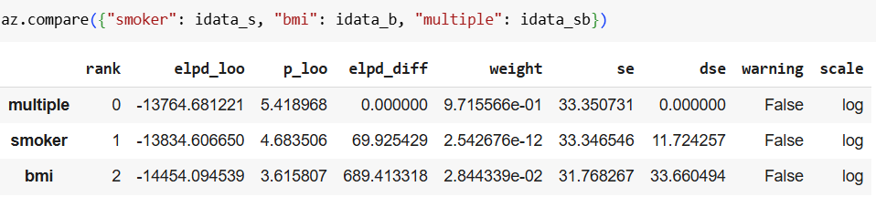
Multiple Regression
Let’s compare the multiple regression model to each of the two simple models:
We can see that the multiple regression model is better than the other two.

Slide 18
Interactions
An interaction effect happens when the effect of an independent variable on the response changes depending on the value of another independent variable.
For example, is the effect of bmi on charges different for smokers and not smokers?
This would be seen in the graph by not parallel regression lines after including the interaction term in the model.

Slide 19

Interactions
How does the regression model look in this case?
$$charges=β_{0}+β_{1}⋅BMI+β_{2}⋅smoker+β_{3}⋅BMI⋅smoker$$
Main Terms
Interaction Term

Slide 20
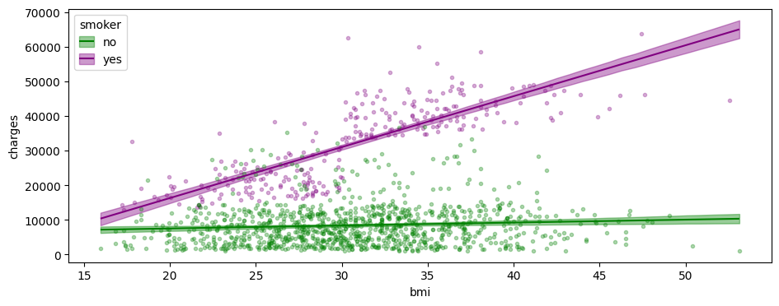
Interactions
Looking at the results of this model shows that now the two regression lines are not parallel.

Slide 21
Interactions
Comparing the results visually of this model and the one without the interaction term show better fit to the data.

Slide 22
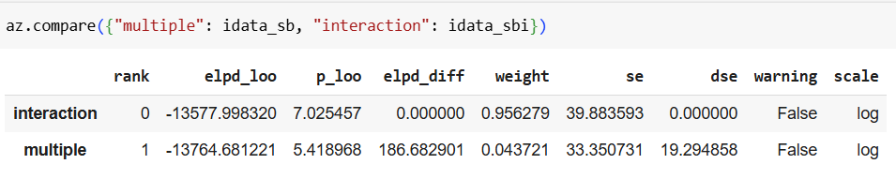
Interactions
Using model comparison also shows that the model with the interaction term is better than the model without.

